Slide 1

Kepler and the Camera Obscura

Slide 2
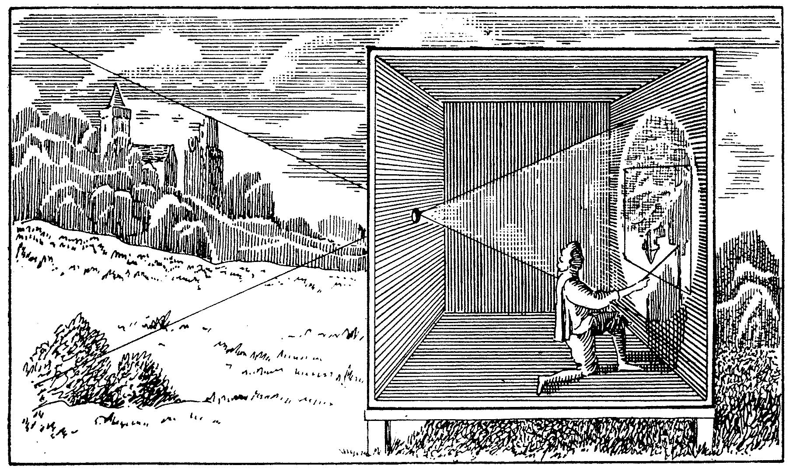
Camera Obscura (ca. 1650)

Slide 3
Analogies and Metaphors
Scientists began to explore mechanical devices as conceptual resources for explaining natural phenomena; i.e., they reasoned by analogy from processes that they thought they understood well to processes that needed explanation.
At the same time, these devices (esp. optical devices) moved to the center of their research interests.

Slide 4
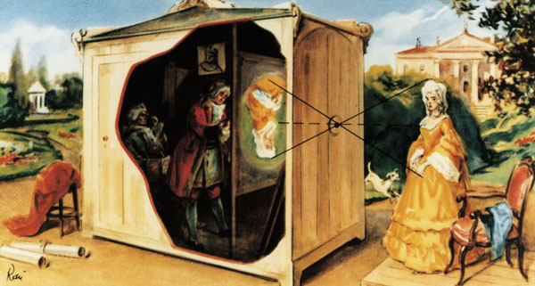
Camera Obscura (ca. 1750)

Slide 5

The camera obscura
Pinhole camera – known since antiquity. A pinhole camera, also known as camera obscura, or "dark chamber", is a simple optical imaging device in the shape of a closed box or chamber (or even a dark room). In one of its sides is a small hole which, via the rectilinear propagation of light, creates an image of the outside space on the opposite side of the box that is projected upside down.
The reason this happens is that light travels in a straight line, but when some of the rays reflected from a bright subject pass through a small hole, they become distorted and end up as an upside-down image. Imagine trying to squeeze an object into a space that is too small for it.

Slide 6
Da Vinci noticed that this is exactly the way the human eye sees things: light reflects off the surface of the object you are looking at and travels through a small opening on the surface of the eye (your pupil), and the image ends up flipped upside down.
He wrote, “No image, even of the smallest object, enters the eye without being turned upside down.” But he couldn't seem to figure out how a human eye actually sees the image right-side up. He didn't know what we know, that the eye’s optic nerve transmits the image to the brain, which then flips it right-side up. So the only thing the camera obscura lacks is a brain to flip the image!

Slide 7
Brahe’s puzzle
The great observational astronomer Tycho Brahe found in 1600 that the lunar diameter as formed by the rays in a camera obscura appeared smaller during a solar eclipse than at other times. Brahe’s observation generated a curious intellectual puzzle that seemed to admit only two solutions: either the Moon itself changed sizes or moved further away from the Earth during the solar eclipse; or Brahe was somehow being deceived by the camera obscura.
Kepler’s solution: The puzzle involves the optics of the visual images (which he called "pictures") formed behind the small apertures in the pinhole camera. The changing diameter of the moon was caused by the inter­section of the optical mechanism with the rays of light. The deception detected by Brahe, Kepler reasoned, is built into the pinhole camera.

Slide 8
Anti-Anthropocentricism
With Kepler’s pioneering work in vision science, the anti-anthropocentrism implicit in Copernicus’ treatment of the Earth as just another celestial body was now bolstered by science. As Kepler's views gathered momentum during the course of the seventeenth century, it is easy to see why natural philosophers (e.g., Robert Hooke and his celebrated illustration of the eye of a grey drone fly) became consumed with studying the eyes of other animals and in recon­structing the world as pictured by their optical mechan­isms.

Slide 9
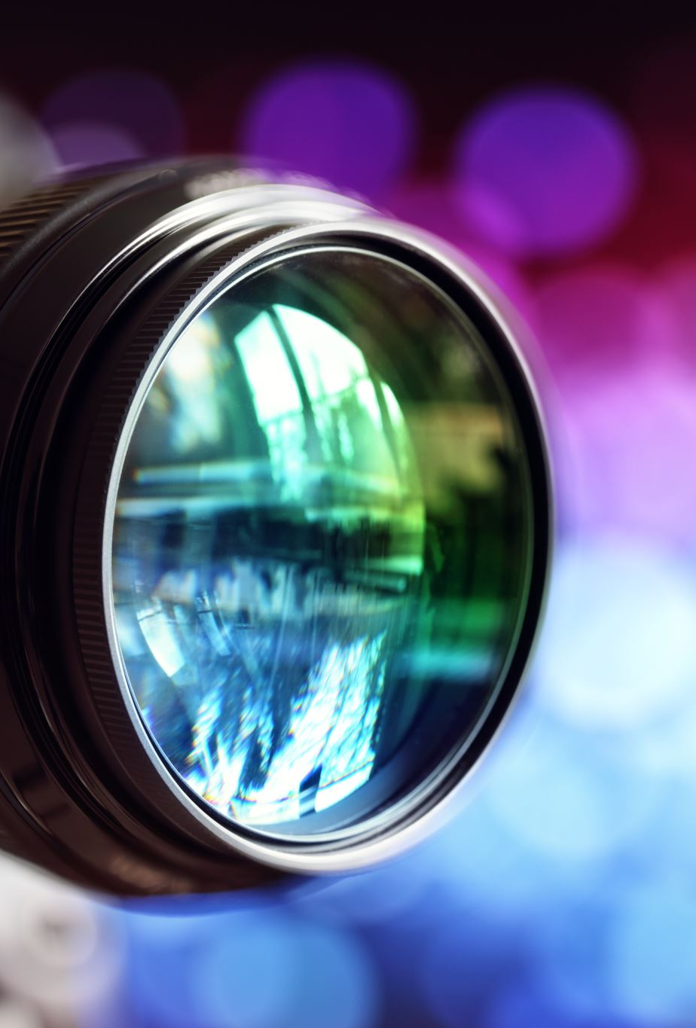
Kepler’s Philosophical Legacy
Kepler’s work with the camera obscura stimulated the direction of philosophy in two ways:
(a) the connection that he drew between seeing and picturing coalesced into a metaphor that described the relation of a perceiver and the position of a knowing subject to an external world; and
(b) the analogy that he drew between the camera obscura and the human eye proved to be instrumental to the creation of the mechanical philosophy.

Slide 10
Visualization as Picture-Making
Kepler’s claim that vision is a kind of picture-making raised a new set of epistemological and psychological problems, concerning the relationship between observer and external world, that resulted in the creation of a philosophical metaphor that profoundly influenced the direction of content of philosophical theory during the seven­teenth century and beyond.

Slide 11
Descartes and Kepler
Descartes then turned to the associated epistemo­logical issues raised by Kepler’s metaphor, taking the view that picturing does not work by denotation, and so the pictures painted on the retina do not require the existence of external objects that resemble these pictures. These issues in the theory of representation have been revisited by contemporary philosophers and are well documented, but few scholars are aware that these issues exploded on the philo­sophical landscape as a consequence of Kepler’s work with the camera obscura.

Slide 12
Kepler’s Influence on British Empiricism
“external and internal sensations … are the windows by which light is let into this dark room … would the pictures coming into such a dark room but stay there and lie so orderly as to be found upon occasion it would very much resemble the understanding of man” (2, 11, 17). The camera obscura, in this passage from John Locke’s Essay Concerning Human Understanding, is used to restructure the process of observation: the operation of the mind is completely separate from the apparatus that allows the formation of “pictures” or “resem­blances.” Locke professes that the manner by which impressions made on the retina by rays of light produce ideas in our minds is “incomprehensible,” but this model was conducive to a juridical role to the observer within the camera obscura that allows the subject to guarantee and to police the correspon­dence between the external world (objects that putatively causer sensations) and interior representations (ideas) and to set aside anything disorderly. The camera obscura, then, as a model of perception was used by Locke to provide an answer to the problem raised by Kepler’s claim that a picture is painted on the retina in vision — namely, scepticism with regard to the senses.

